Slide 1
Prolog
Sec 9
Trees 1

Slide 2
Agenda
Introduction to trees
Displaying tree nodes
Displaying leaf nodes
Hands-on: Search for item X in binary dictionary
Calculate tree depth
Add leaf to dictionary

Slide 3
Trees
Tree is an object in prolog that can carry many values as the list.
One kind of trees is named “binary tree” it contains a node (root) and descend from it only two nodes (left and right).
Binary dictionary: is a kind of binary tree; which we will study, but has specific feature; left node always has value smaller than its root right node always has value bigger that its root

Slide 4
Trees
Tree is a new data type in the prolog and so we will have to define it in the domains section.
The tree contains roots and each root has left node (which can be a complete tree) and right node (which can be a complete tree), if we reaches the end node and there is no more trees we put “nil” which means an empty tree.
In defining the tree object in the domains section, it has functor and parts as the compound object.

Slide 5
t(t(nil,b,nil),a,t(t(nil,d,nil),c,nil))
domains
tree= t(tree,symbol,tree);nil
Empty tree
root
a
Left Node
(tree)
Right Node
(tree)
b
c
d

Slide 6
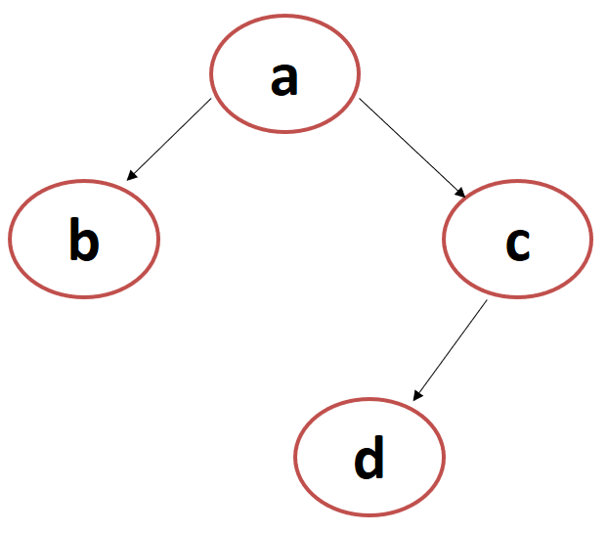

1. Displaying Tree Nodes
domains
tree= t(tree,symbol,tree);nil
predicates
nondeterm display(tree)
Clauses
display(nil).
display(t(Left, X, Right)) :-
write(X),nl,
display(Left),display(Right).
goal
display( t ( t(nil,b,nil) , a , t( t(nil,d,nil), c , nil) ) ).
Write node while going to left most node, then go right
Notes:
Reach the last most left node then get its right nodes

Slide 7
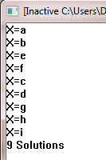
a
b
c
e
f
d
i
g
h
goal
in(X, t ( t(t(nil,e,nil),b,t(nil,f,nil)) , a , t( t(t(nil,g,nil), d ,t(nil,h,nil)), c , t(nil,i,nil)) ) ).

Slide 8

Who to display the tree in ascending order ??
10
5
20
1
8
18
22
12
19
goal
display(t ( t(t(nil,1,nil),5,t(nil,8,nil)) , 10 , t( t(t(nil,12,nil), 18 ,t(nil,19,nil)), 20 , t(nil,22,nil)) ) ).

Slide 9
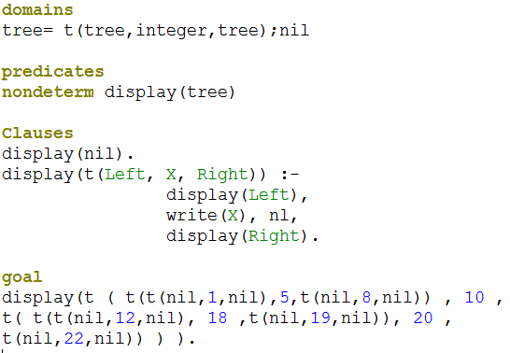
1. Displaying Tree Nodes in ascending order
Go to left most node, then write node then go right
Notes:
Reach the last most left node then get its right nodes

Slide 10
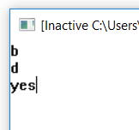
2. Displaying Leaf Nodes
domains
tree= t(tree,symbol,tree);nil
predicates
nondeterm display(tree)
clauses
display(t(nil, X, nil)):- write(X),nl,!.
display(t(Left, X, Right)) :-
display(Left),display(Right).
goal
display( t ( t(nil,b,nil) , a , t( t(nil,d,nil), c , nil) ) ).
Stop when reach leaf
Notes:
Reach the last most left node then get its right nodes

Slide 11
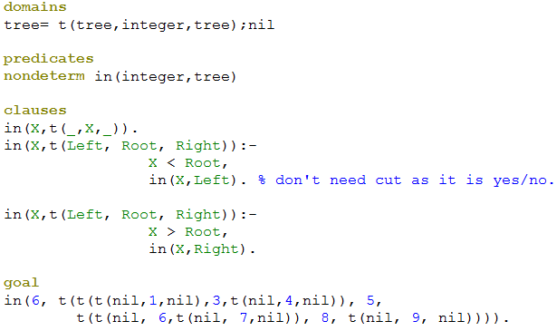
3. Hands-on: Search for item X in Binary dictionary

Slide 12
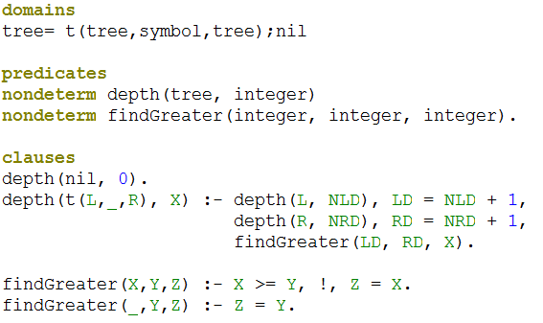
4. Calculate Tree Depth

Slide 13
5. Add leaf to dictionary
domains
tree=t(tree,integer,tree);nil
predicates
nondeterm addleaf(tree,integer,tree)
Given dictionary tree
Element wants to add it to the given tree
Output tree contains the given element

Slide 14
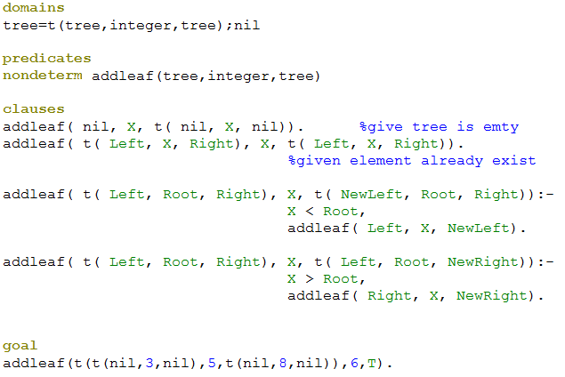
5. Add leaf to dictionary

